Slide 1
Angular 8 - Day 5
HttpClient, Observables, and Forms

Slide 2
Vignesh Murali Natarajan (119780), Edit by Jason Monroe (688776)
Veteran Trainer, Project Manager and Solution Architect with 14 years of technical training experience and 12 technical certifications on Java, Mobile, Web, Architecture, Design and Development
2.0, May 2019

Slide 3

Objectives
In this session we will be covering the following topics:
HttpClient
Introduction
Observables
Subscriptions
Get() and Post()
Forms
Introduction
Template Driven Forms
Model Driven Forms
Form Validation

Slide 4
HttpClient

Slide 5
HttpClient Service
HTTP calls from an application can be made through the HttpClient service that belongs to @angular/common/http module.
It supports both XHR and JSONP requests exposed through the HttpModule and JsonpModule respectively.
The HttpClient service exposes methods for every HTTP method –get(), put(), delete(), post() etc. All of these methods return Observables.
HttpClient is a built-in service and has to be inserted using Dependency Injection to the components in need. It must also be added as an import to the app.module.ts

Slide 6
Observables
Observables are mechanisms to open up a continuous channel of communication between two components, in which multiple values of data can be emitted over time to all subscribers.
This is similar to a pattern of dealing with data by using array-like operations to parse, modify and maintain data.
Observables are not Angular specific features, rather a proposed standard for managing asynchronous data that was included in ES7.
Observables belong to RxJs Module and needs to be imported accordingly.

Slide 7
Subscription
Observables Subscription:
Observables can be listened-to using the following methods:
subscribe – This method accepts three callback functions in the below order:
Progress callback – it is called every time the observable posts a new value.
Error callback – It is called when the observable posts an error.
Completion callback – It is called when the observable signals successful completion.
foreach – This method is a wrapper around the subscribe method, returning a promise object. The promise is resolved or rejected based on success or failure respectively.

Slide 8
Subscription (Contd.)
Observables Subscription using subscribe:
<<method that returns an Observable>>.subscribe(
progress(data){},
error(error){},
complete(data){}
);
In the Observer, initiating an unsubscribe:
data.unsubscribe();

Slide 9
Un-subscribe
Observable subscription objects support an unsubscribe method to cancel subscription, when invoked.
While “unsubscribe” is typically triggered from the subscribers, the observable can also react by using the “onUnsubscribe” method.
Observables may return an “onUnsubscribe” function, detailing what needs to be done at the observable’s end when a subscriber unsubscribes.

Slide 10
Un-subscribe (Cont)
In the Observable definition, defining an unsubscribe handler:
const data = new Observable(observer => {
setTimeout(() => {
observer.complete();
}, 3000);
return onUnsubscribe = () => {
//some cleanup here
}
});

Slide 11
HttpClient Service (Contd.)
An HttpClient get request sends a url. The pipe method is used to ‘stitch together functional operators into a chain’
catchError and map methods shown above must be imported from rxjs/operators
Below invocation posts a http request and reacts using the subscribe method callbacks – Progress, Error and Completion.
httpClient.get<Model>(url).pipe(
map(response => return response),
catchError(this.handleError<any>());
);
httpClient.post<Model>(`${ BASE_URL }/auth/login`, payload)
.map(response => response.json())
.subscribe(
authData => this.storeToken(authData.id_token),
(err) => console.error(err),
() => console.log('Authentication Complete')
);

Slide 12

HelloAngular – HttpClient and Observables
Update the DeveloperService to retrieve the live data from an API
Import HttpClient, Observable, catchError, and map.
Inject HttpClient in constructor and delete ‘hard coded’ developers
Change the return type of the getAllDevelopers() method to Observable<Developer[]>
url is https://developer-service-overspeedy-celebratedness.cfapps.io/developers
Use http.get with the above url and return the response
Subscribe to the getAllDevelopers() method in the bio.component.ts call
Add HttpClientModule to app.module.ts
Notes:
Instructions to Trainer:
Instructions to Facilitator:

Slide 13
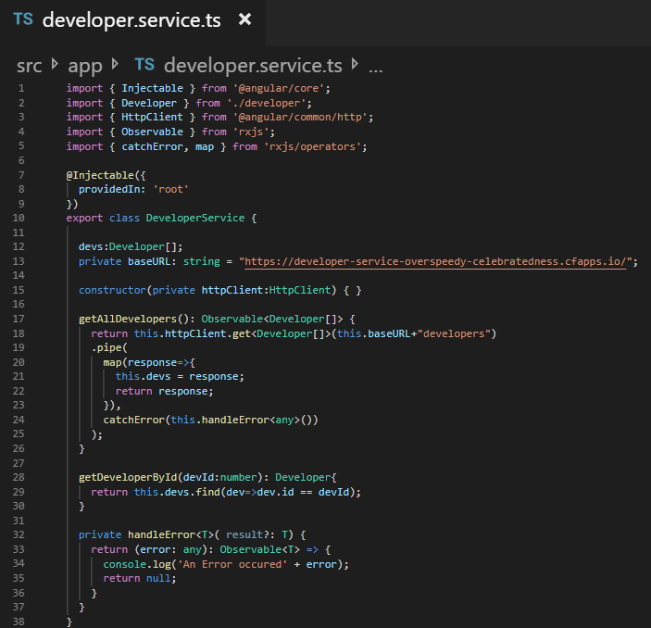
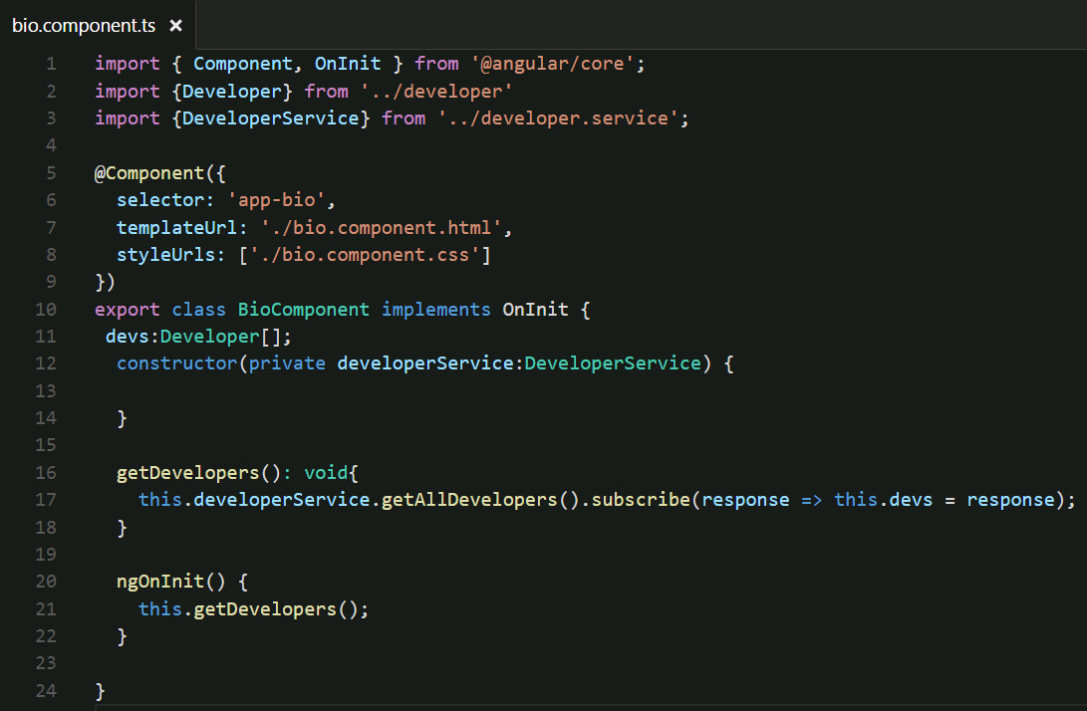
HelloAngular –Using Http and Observables
#1
#2
Notes:
Instructions to Trainer:
Instructions to Facilitator:

Slide 14
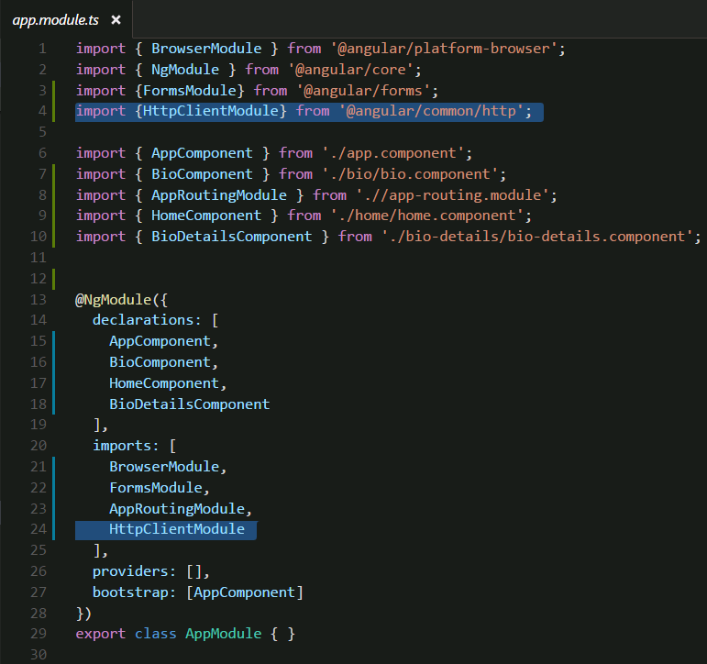
HelloAngular –Using Http and Observables
#3 ->
Notes:
Instructions to Trainer:
Instructions to Facilitator:

Slide 15
Forms

Slide 16
Introducing Forms
Angular gives degrees of simplicity and power, depending on the form's purpose, when it comes to Form Support. The following types of Form handling are supported:
Template-Driven Forms place most of the form handling logic within that form's template
Support for these forms are extended by the FormsModule
Model-Driven (also known as Reactive) Forms place form handling logic within a component's class properties and provides interaction through observables
Support for these forms are extended by the ReactiveFormsModule

Slide 17
Template Driven Forms
Template Driven forms provide instantaneous two-way data binding between the model (component attributes) and form elements.
This approach allows transparently keeping a form with its view model in-sync.
Forms built this way can only be tested in an end-to-end test, because this requires the presence of a DOM. Albeit this, the mechanism is still very useful and simple to understand.
The directive provided by Angular to support Template Driven forms is ngModel.

Slide 18
Template Driven Forms (Contd.)
ngForm:
Angular comes with a directive ngForm that matches the <form> selector.
ngForm provides information about the current state of the form including:
A JSON representation of the form value
Validity state of the entire form
The ngForm directive exposes its internals for use in the html form. A hypothetical definition of form by Angular is given below. Note the exportAs attribute usage.
@Directive({
selector: ‘form',
exportAs: ‘ngForm'
})
class Form {
...
}

Slide 19
Template Driven Forms (Contd.)
The exposed ngForm can be used using Angular local variables:
ngModel:
To register form controls on an ngForm instance, you use the ngModel directive. In combination with a name attribute, ngModel creates a form control abstraction behind the scenes.
Every form control that is registered with ngModel will automatically show up in form.value, then can easily be used for further post processing.
<form #form="ngForm">
...
</form>
<form #form="ngForm" (ngSubmit)="logForm(form.value)">
<label>Firstname:</label>
<input type="text" name="firstname" ngModel>
</form>

Slide 20
Template Driven Forms (Contd.)
ngModel (Contd.):
When used without a value, ngModel indicates that its hosting form element should be part of the Angular form.
When used with an expression, ngModel lets the form element to be bound to an existing domain model.
<fieldset ngModelGroup="name">
<label>Firstname:</label>
<input type="text" name="firstname" [(ngModel)]="firstname">
<p>You entered {{firstname}}</p>
<label>Lastname:</label>
<input type="text" name="lastname" [ngModel]="lastname">
<p>You entered {{lastname}}</p>
</fieldset>
@Component({
selector: 'app',
template: ...
})
class App {
firstname = 'Pascal';
lastname = 'Precht';
}

Slide 21
Template Driven Forms (Contd.)
ngModelGroup:
ngModelGroup enables semantic grouping of form controls.
It also tracks validity state of the inner form controls. This is very handy, if the validity state of a subset of the form needs to be checked.
<fieldset ngModelGroup="name">
<label>Firstname:</label>
<input type="text" name="firstname" ngModel>
<label>Lastname:</label>
<input type="text" name="lastname" ngModel>
</fieldset>
<fieldset ngModelGroup="address">
<label>Street:</label>
<input type="text" name="street" ngModel>
<label>Zip:</label>
<input type="text" name="zip" ngModel>
</fieldset>

Slide 22
Model Driven Forms
Reactive forms lets definition of forms through code and gives more flexibility and control over data validation.
Model-driven forms enable to test forms, without relying on end-to-end tests like Template Driven Forms does.
Reactive forms are more like an addition to template-driven forms, although, depending on what you are doing, few things can be left out here and there (validators on DOM elements and so on).
Reactive forms are driven by components, directives, and providers like FormBuilder, FormGroup, and FormControl.
To create model-driven forms, create a form model that represents that DOM structure in the component.
This can be done by using the low level APIs for FormGroup and FormControl.

Slide 23
Model Driven Forms (Contd.)
formGroup To tell Angular that a form model is responsible for the corresponding form template, the formGroup directive can be used. The formGroup takes an expression that evaluates to a FormGroup instance.
ngSubmit The method in the Component that gets called on submit
<form (ngSubmit)="save()" [formGroup]="registerForm">
...
</form>
FormBuilder is a factory that creates FormGroup’s and FormControl’s for you. All you need to do is to import it and use its .group() method.
export class AppComponent implements OnInit {
registerForm: FormGroup;
ngOnInit() {
this.registerForm = this.formBuilder.group({
firstname: new FormGroup(‘’),
lastname: new FormGroup(‘’),
address: this.formBuilder.group({
street: new FormGroup('',Validators.required
zip: ['‘,Validators.required]
})
});
}
}

Slide 24
Model Driven Forms (Contd.)
formGroupName is used to associate a group of form controls to its model. A surrounding element is needed for hosting the formGroupName element and grouping the form group.
<fieldset formGroupName="address">
<label>Street:</label> <input type="text" formControlName="street">
<label>Zip:</label> <input type="text" formControlName="zip">
</fieldset>
FormData is used to package all of the form data for use in a POST request. Use the get method of the FormGroup object and the value property to retrieve the user input, then use the append method
save(){
let formData = new FormData();
formData.append(‘firstName', this.registerForm.get('firstName').value);
formData.append(‘lastName', this.registerForm.get('lastName').value);
this.http.post(this.url, formData)//post method receives a FormData object
.subscribe(res => {
}, (err) => {
console.log(err);
});
}

Slide 25
HelloAngular – Posting with MD Forms
Create a new component called BioCreate (ng g component BioCreate).
Add a route to this component in your app-routing.module.ts
Add a link to this component in your nav bar (app.component.html)
Create a reactive form in the bio-create component that will create a new developer bio.
Import FormsModule and ReactiveForms in your app.module.ts
Create the form with (ngSubmit)=saveDeveloper() and [formGroup]=“devForm”. Use these formControlName values: firstName, lastName, favoriteLanguage, yearStarted
In the bio-create.component.ts:
Import FormGroup, Router, FormBuilder, Validators, and DeveloperService.
Create a member variable called devForm to match the formGroup name above and set it equal to a new form group containing all of the inputs.
Inject Router, FormBuilder, developerService
Create the saveDeveloper() method that is being called from (ngSubmit). It should create a FormData object, append to it each element from devForms and then send that object to developerService.addDeveloper(formModel: FormData). Navigate back to /bio using this.router.navigate().
Write the addDeveloper to post the FormData to https://developer-service-overspeedy-celebratedness.cfapps.io/developer.
Notes:
Instructions to Trainer:
Instructions to Facilitator:

Slide 26
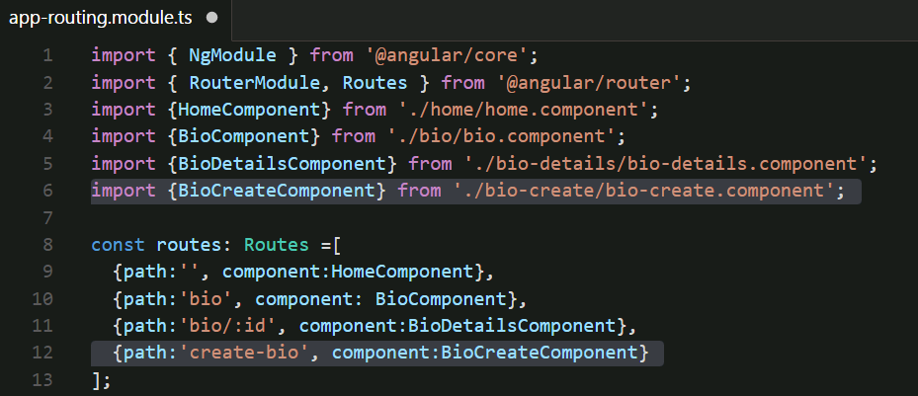
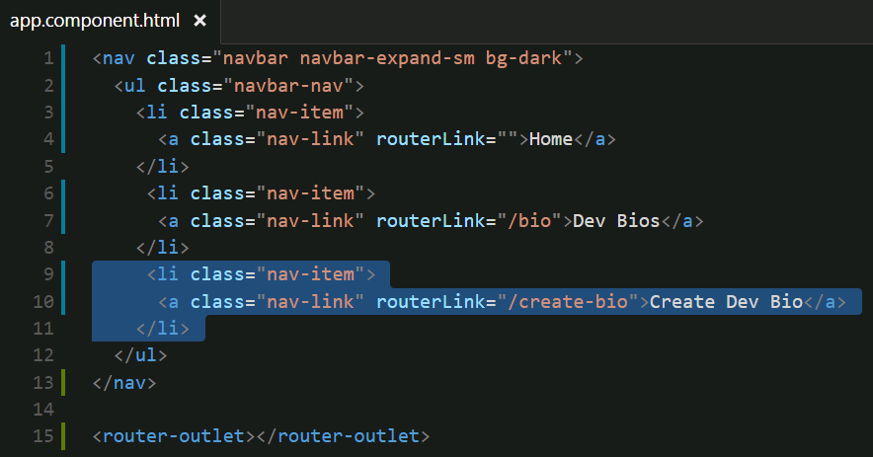
HelloAngular – Posting with MD Forms
#1 a
#1 b
Notes:
Instructions to Trainer:
Instructions to Facilitator:

Slide 27
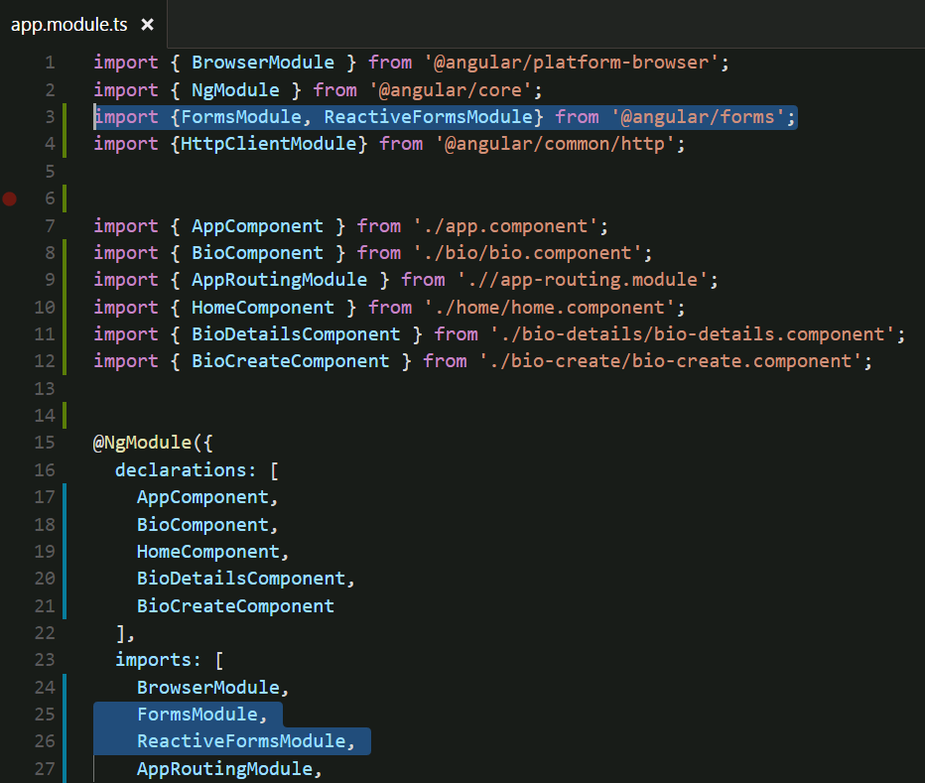
HelloAngular – Posting with MD Forms
#2 a ->
Notes:
Instructions to Trainer:
Instructions to Facilitator:

Slide 28
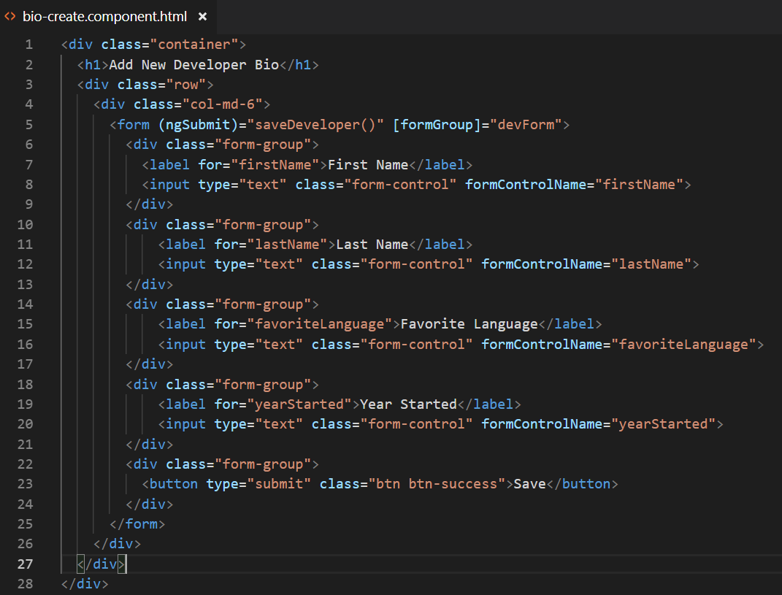
HelloAngular – Posting with MD Forms
#2 b ->
Notes:
Instructions to Trainer:
Instructions to Facilitator:

Slide 29
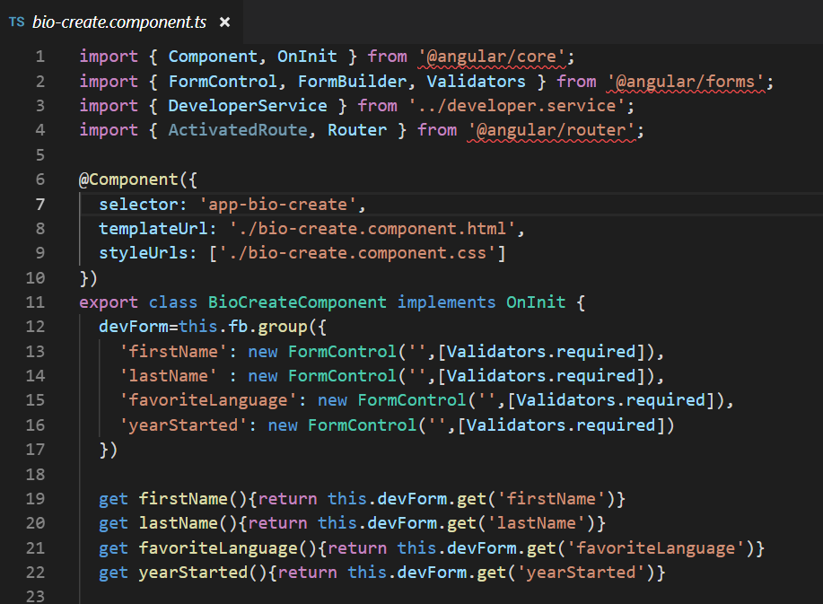
HelloAngular – Posting with MD Forms
#2 c 1-3
Notes:
Instructions to Trainer:
Instructions to Facilitator:

Slide 30
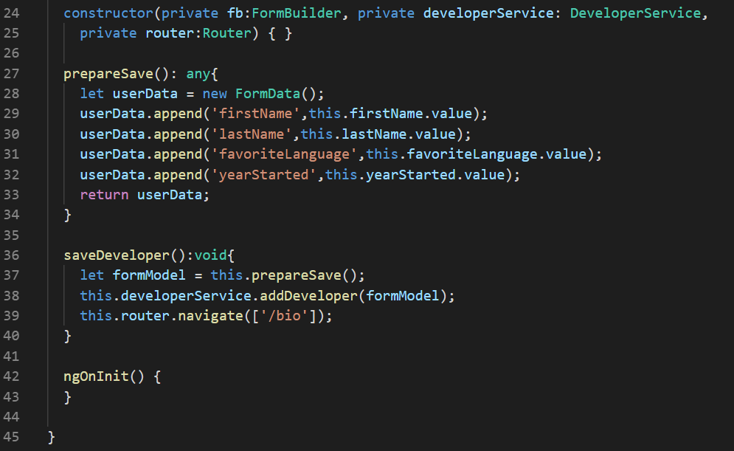
HelloAngular – Posting with MD Forms
#2 c 4
Notes:
Instructions to Trainer:
Instructions to Facilitator:

Slide 31
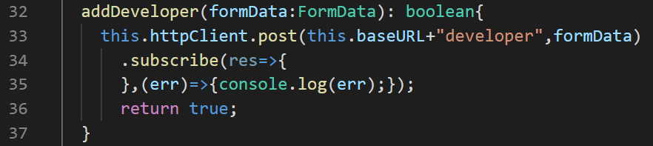
HelloAngular – Posting with MD Forms
#3 developer.service.ts
Notes:
Instructions to Trainer:
Instructions to Facilitator:

Slide 32
Form Validation – Built-in
Template-driven forms are validated using HTML5 validators.
<!-- a required field -->
<input type="text" required>
<!-- an optional field of a specific length -->
<input type="text" pattern=".{3,8}">
<!-- a non-optional field of specific length -->
<input type="text" pattern=".{3,8}" required>
<!-- alphanumeric field of specific length -->
<input type="text" pattern="[A-Za-z0-9]{0,5}">
<!-- a field which will accept no more than 5 characters -->
<input type="text" maxlength="5">
Model-driven forms can be validated by Angular’s in-built validators and take a different route from that of Template-driven forms.
export class AppComponent {
username = new FormControl('', [
Validators.required,
Validators.minLength(5)
]);
}

Slide 33
Form Validation – Model Driven Custom
As useful as the built-in validators, it is very useful to be able to include custom validators that suit adhoc functional needs. Angular allows just that, with minimal effort.
To use custom validators, define the validation function in the component.
function hasPunctuation(punctuation: string, errorType: string) {
return function(input: FormControl) {
return input.value.indexOf(punctuation) >= 0 ?
null :
{ [errorType]: true };
};
}
Registering the validator for a field
password = new FormControl('', [
Validators.required,
hasPunctuation('&', 'ampersandRequired‘)
]);

Slide 34


Questions

Slide 35
Test Your Understanding
Explain the steps to make an HttpClient get call in Angular ?
What are the different types of Forms?
What are the advantages of Model Driven Forms?
Notes:
Instructions to Trainer:
Instructions to Facilitator:

Slide 36
You have successfully completed
HttpClient, Observables, and Forms

Slide 37
Thank You

